Slide 1

LOLMOVIES.com
LOLMOVIES.com
The Best Comedy movies.
DBMS Final Assignment | Michal Berkheim, Michal Lahav, Reshit Carmel | 2025

Slide 2

LOLMOVIES.com Overview
// TODO – RESHIT
The 1000 top-rated full-length comedy movies of all times in the US, English Language, sorted by popularity (DESC)
// פלט גולמי עבור כל דוגמה נמצא בקובץ טקסט בגיט, אם למישהי יש כוח לשים את הנתונים האלו כאן...

Slide 3




LOLMOVIES.com Main Webpage

Slide 4




LOLMOVIES.com Q1: FULLTEXT Search – Title\Overview
⌕ space
“space” in title
“space” in overview

Slide 5




LOLMOVIES.com Q2: FULLTEXT Search – keyword
⌕ witch

Slide 6
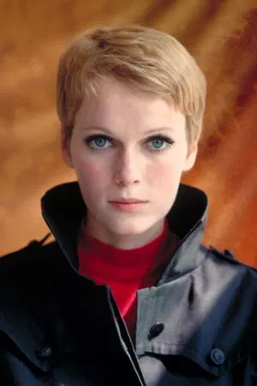

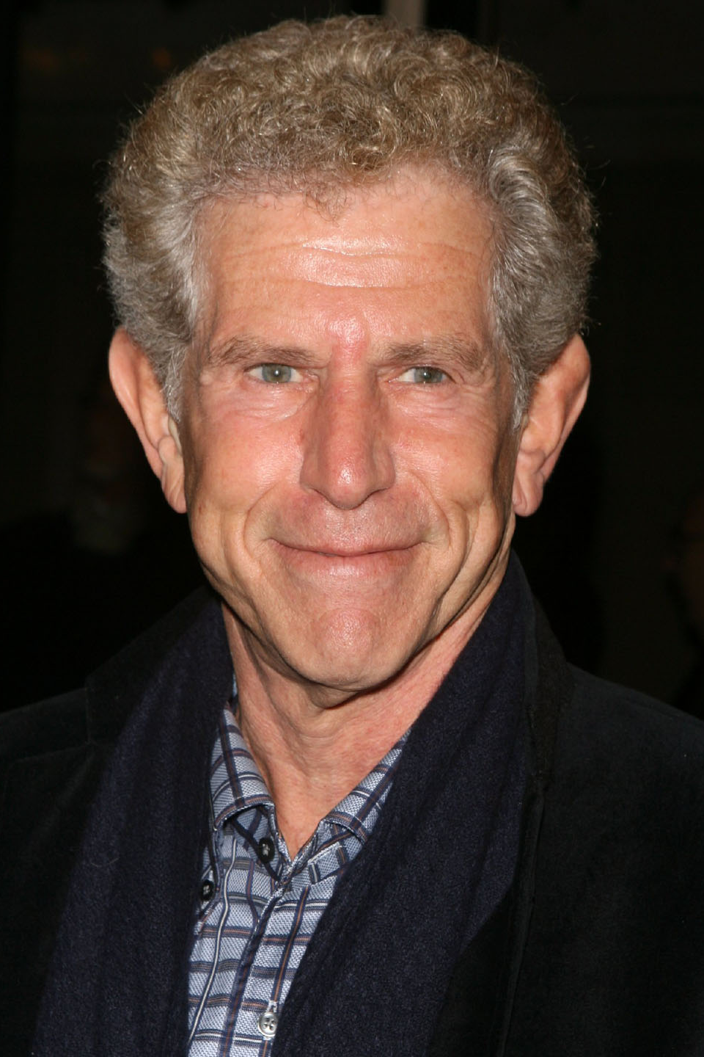
LOLMOVIES.com Q3: Director's favorite actors
⌕ Woody Allen

Slide 7
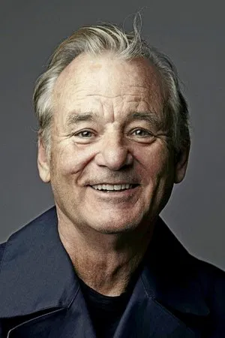

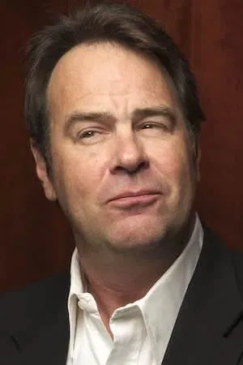
LOLMOVIES.com Q4: Hall of Fame
⌕ 1980, fantasy

Slide 8




LOLMOVIES.com Q5: Hidden Gems
⌕ 2012

